Slide 1



Data Series Fair 17.0
PORTFOLIO ASSIGNMENT
Business Intelligence
by Kania Tri Hapsari

Slide 2
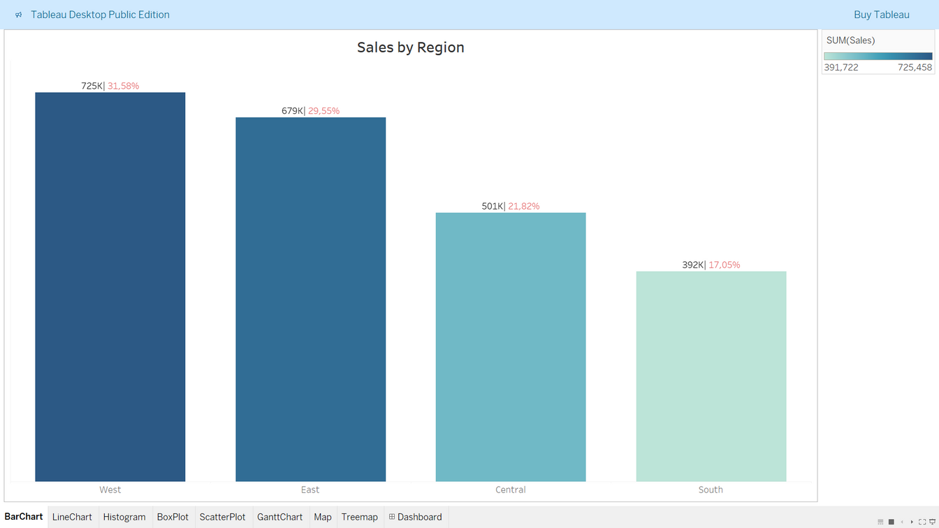
Bar Chart
This chart are used to compare sales performance by region.
Insight:
West region has the highest sales with a percentage of 31,58%.
Meanwhile, South region has the lowest sales with a percentage of 17,05%.
The difference between the highest and the lowest is 333.736.

Slide 3
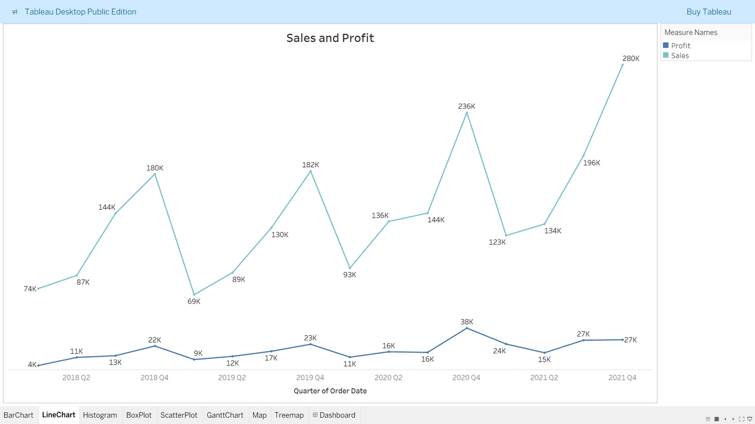
Line Chart
This chart are used to show the relationship between sales and profit. It shows the distribution in quarters of order date.
Insight:
The highest sales occurred in the fourth quarter of 2021 with a profit of 27k.
The highest profit occurred in the fourth quarter of 2020 with the second highest sales of 236k.

Slide 4
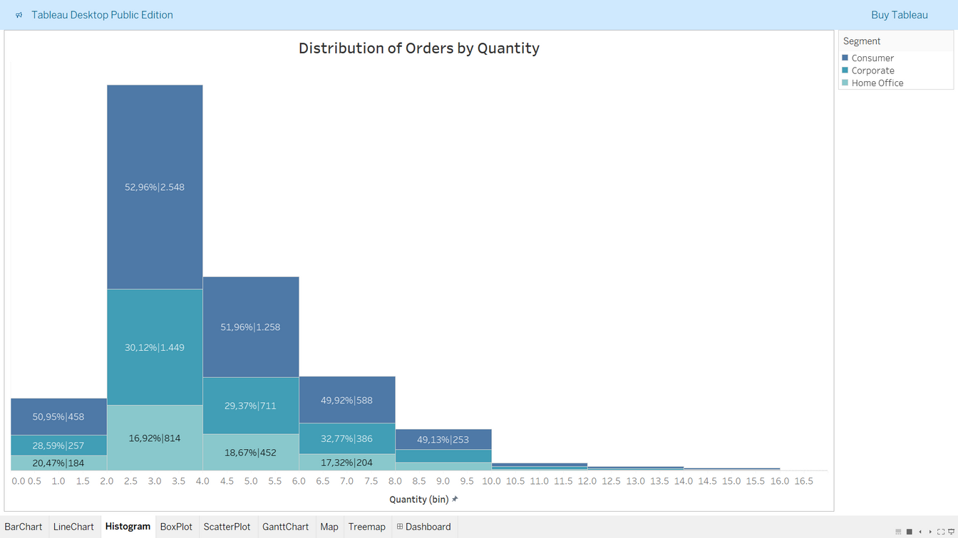
Histogram
This chart are used to show the distribution of orders by quantity.

Slide 5
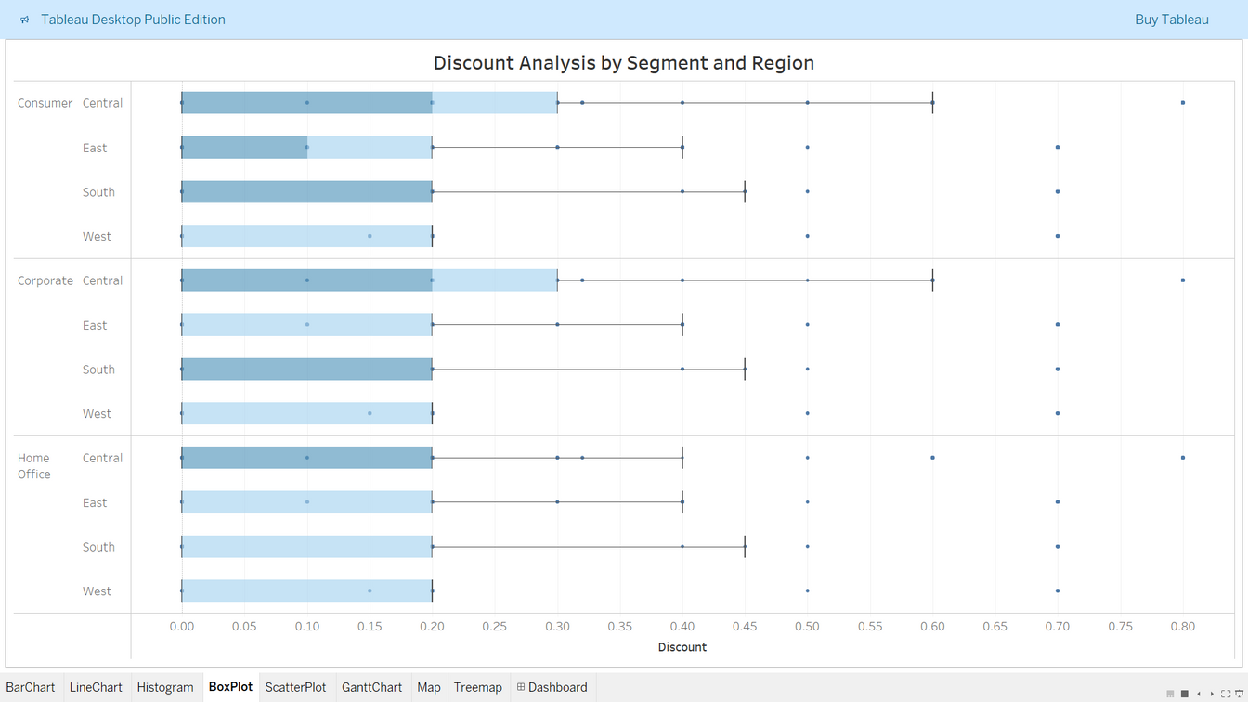
Box Plot
This chart are used to show the distribution of discount by segment and region.
Insight:
In the central region, both customer and corporate segments, have the highest discounts.
In the west region, all of the segments have the lowest discounts.

Slide 6
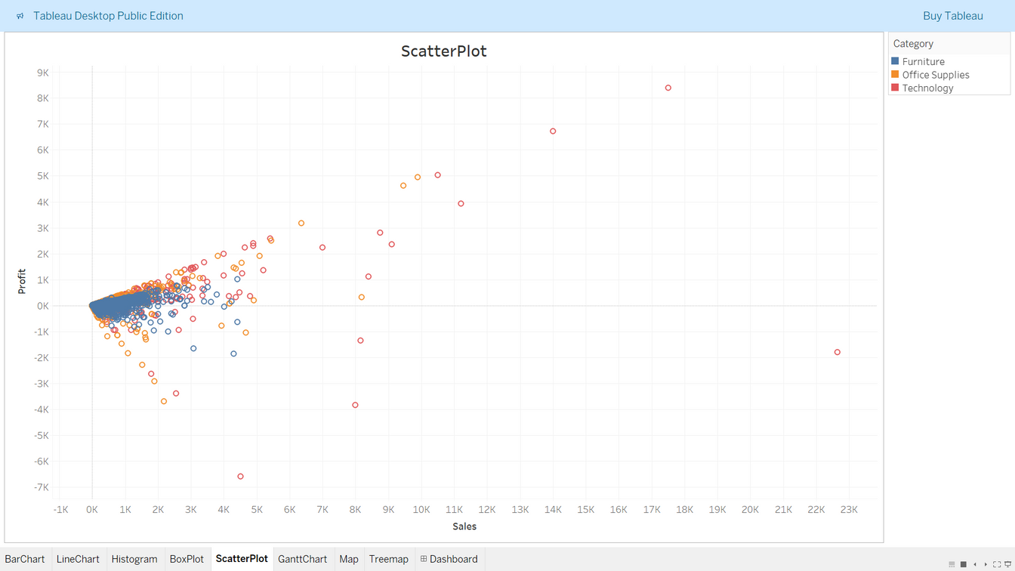
Scatter Plot
This chart are used to visualize the relationship between profit and sales.

Slide 7
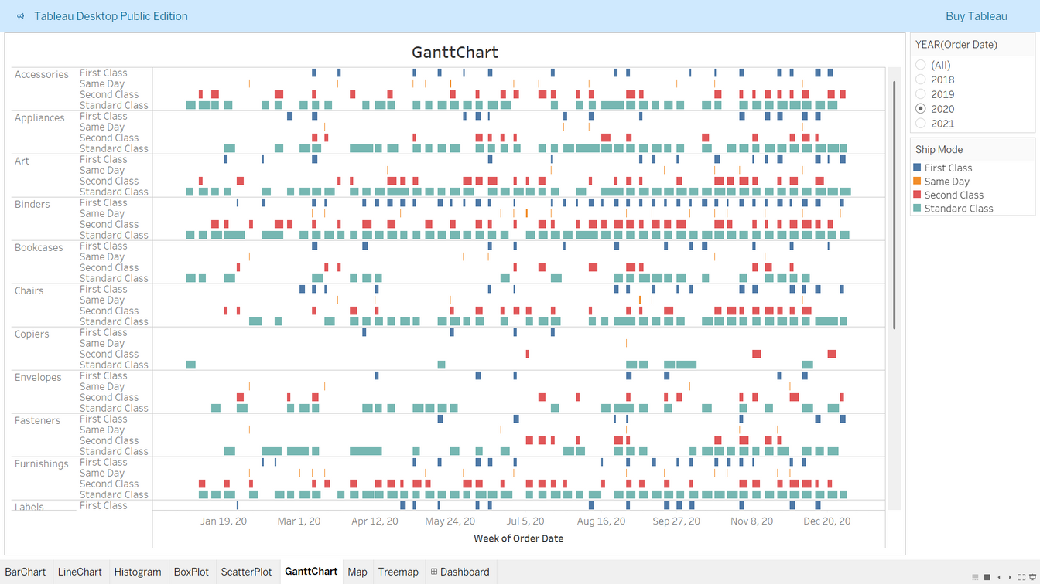
Gantt Chart
This chart are used to show the duration of order. It shows a project's timeline and tasks, which helps teams to manage and track projects.

Slide 8
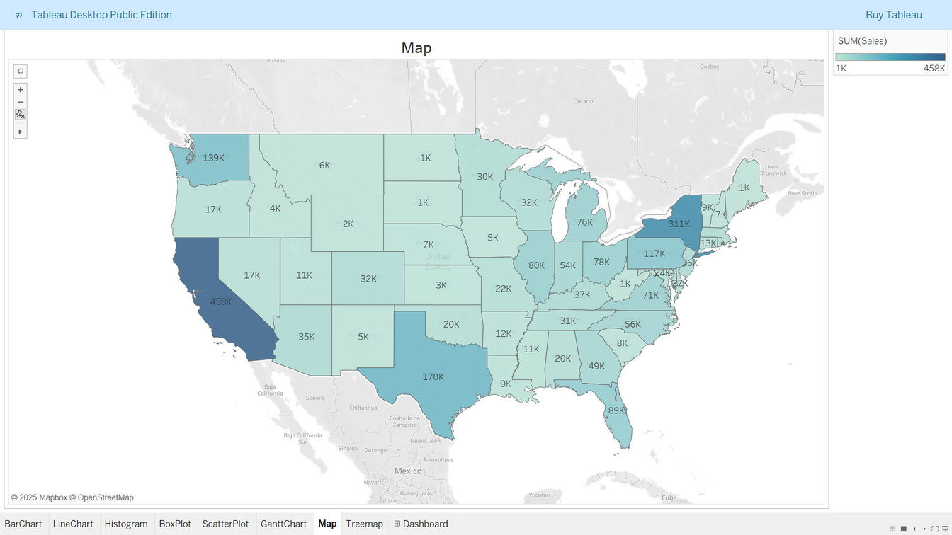
Map
This chart are used to show the distribution of sales by region.
Insight:
California has the highest sales in United States.
Some states have the lowest sales, such as North Dakota, South Dakota, West Virginia, and Maine.

Slide 9
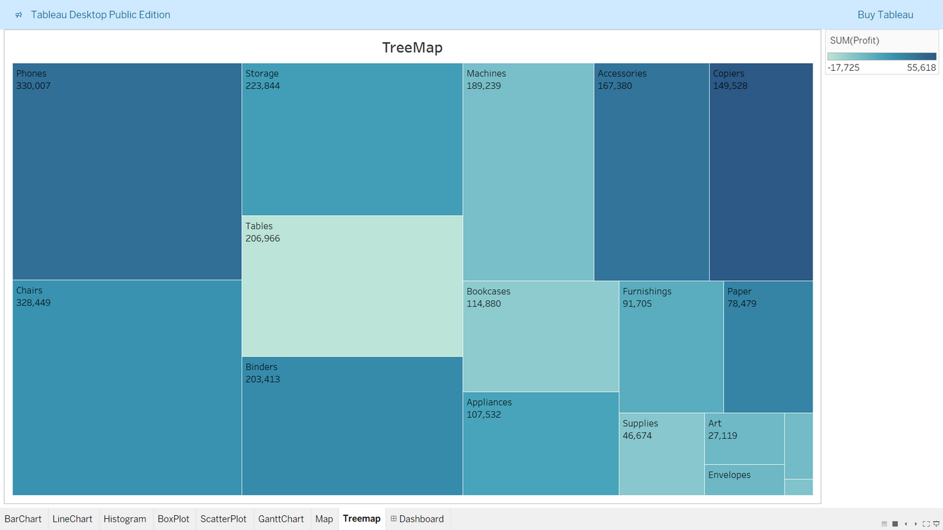
Tree Map
This chart are used to display such as categories and data proportions.
Insight:
Phones under technology category has the highest sales and fasteners under office supplies has the lowest sales.
By the color gradient, copiers under technology category has the highest profit and tables under furniture category has the lowest.

Slide 10
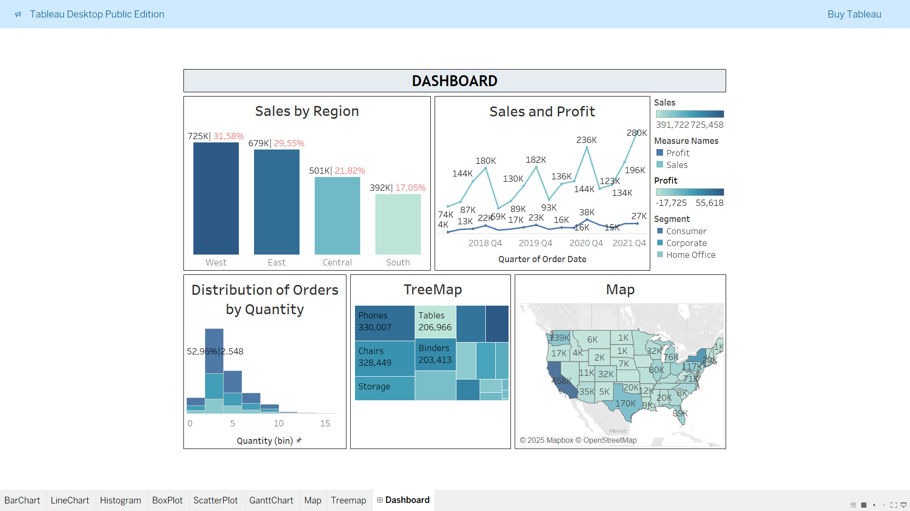
Dashboard of Data Visualization

Slide 11
THANK
YOU
Check out my profile and project at:
linkedin.com/in/kaniatrihapsari17
github.com/happ-learn/visualization-in-tableau.git
Data Series Fair 17.0
Business Intelligence

